Slide 1
Section 4
Week of February 25

Slide 2
Outline
A few notes
OOP
ORM
APIs

Slide 3
A few notes:
Project 1 due on March 4th

Slide 4
OOP: Object Oriented Programming
A programming paradigm based on objects
In python we have classes:
These can have variables and methods
An object, is an instance of a class
Keywords: class, object, method, instance

Slide 5
ORM: Object Relational Mapping
Using python classes with a SQL database
Define one class per table
Using Flask-SQLAlchemy
Do not use ORM for Project 1

Slide 6
API: Application Programming Interface
Method for one application communication to another (or another part of the same program)
Benefit: you don’t need to worry about what the other application is doing
Pass data using JSON format

Slide 7
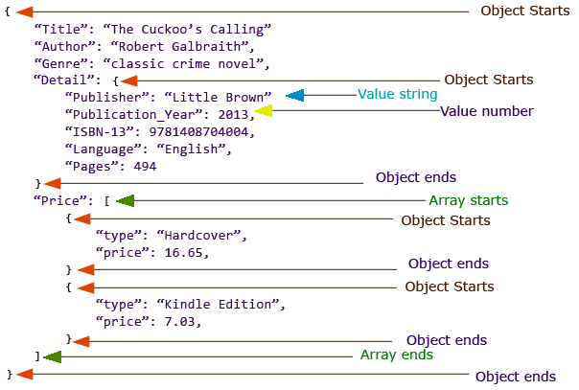
JSON: Javascript Object Notation
https://www.w3resource.com/JSON/introduction.php

Slide 8
Any remaining questions?

